Slide 1

TENASITY
Jared Bennett, Biter Bilen, Julide Bilen (Yes, sisters), Mike D'Amour, Sarah Daniels, Kubilay Demir , Holly Deremo, Steven Ganz, Christian Dima Lituiev, Sree Vaddi, Chase Violet, Rena Yang
SVAI Undiagnosed-1, SF/Toronto/London
June 9th, 2019

Slide 2
Outline
Research Summary
Project Outline
Deep Dive into Recommended Targets
Conclusions and Strategic Recommendations
2

Slide 3
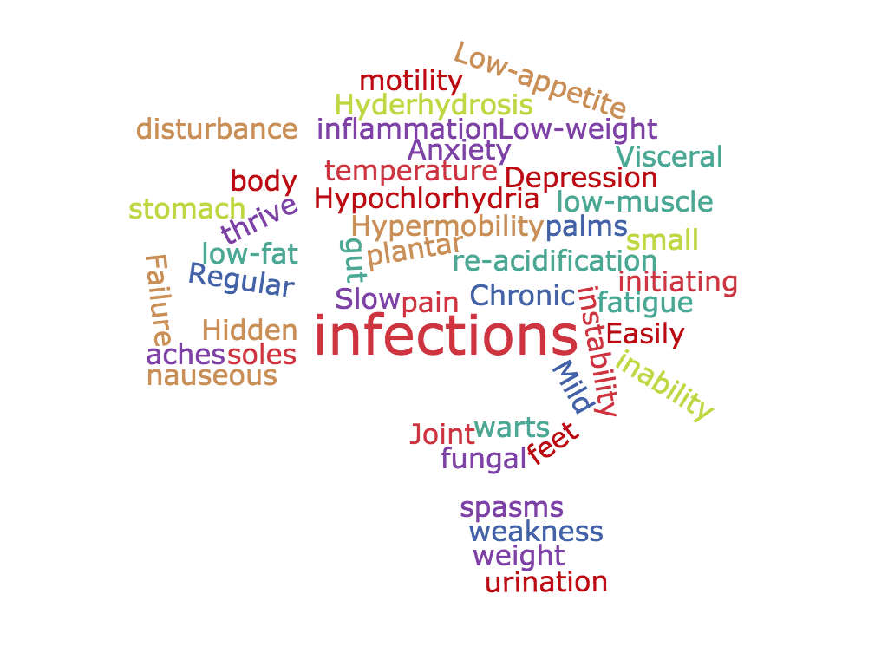
John's Symptoms
3

Slide 4
Tenacity Specific Targets for Future Research
TNXB Tenascin is the top priority to pursue in the near term according to our analysis and primary research
TNXB
John should next consider a variety of high value targets due to high potential and reasonable inherent risks
Alg11 ATP7B PLCD4
John should avoid these targets due to false-positiveness and further check genome-wide Q/C
CCK, CCK_RA, CCK_RB
4

Slide 5
Project Outline

Slide 6
Tenacity Workflow for Gene-Variant Analysis
Variant phenotype confirmation
Cross-validation
Literature Search
Druggability
Developmental phenotypes
Clinical trials
Score
Is the variant passes certain confidence criteria
Can it be confirmed with deep-exon sequencing
Is this target closely related to a disease state?
Is there clinical evidence exist on this target?
Is it of clinical interest
Is gene’s function required early on development
Weighted final scoring
6

Slide 7
Further and partial validation of data sets via Deep Exome & Sentieon Venn Diagram
357
483
266
Sentieon Data
Deep Exome Data
7

Slide 8
Deep Dive into Recommended Targets

Slide 9
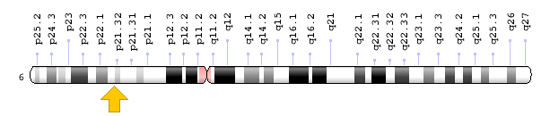
Tenascin-X(TNXB) Partially Lost in John's Case
Variant involves frame shift
An extracellular-matrix protein
Required for organismal architectural
Evolutionary conserved suggesting architectural protein, as it displays features of a matricellular matrix by modulating cell adhesion
TNXB-deficiency leads to greater symptoms of reflux, indigestion and abdominal pain.
Partial relief from GABA-B agonists, like benzodiazepines (which John currently takes and have worked)
Known to be mutated in Ehlers-Danlos type III disease patients
9

Slide 10
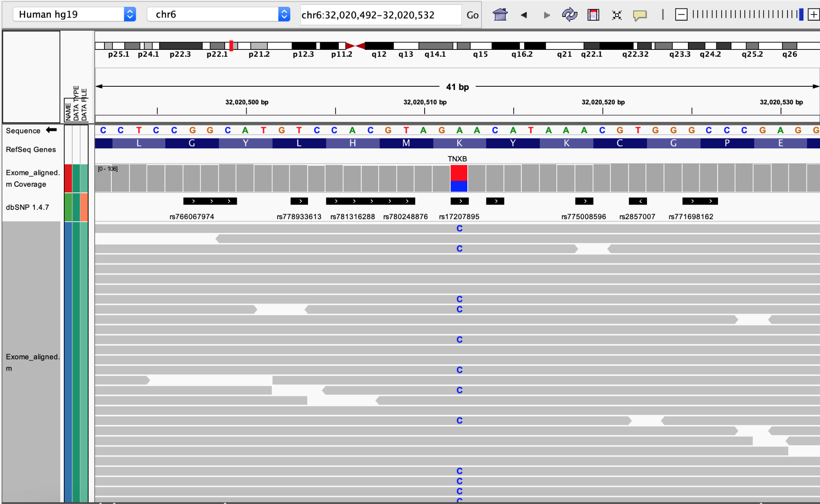
TNXB Variant is Heterozygous
10
Notes:
IGV

Slide 11
Ehlers Danlos III Syndrome
Group of connective tissue disorders
Reduces the amount of functional tenascin-X produced
Weakens connective tissues in many parts of the body, which leads to signs and symptoms of hypermobility
Additional symptoms include numerous ties to GI dysmotility disorders, as well as other functional disorders like Gastric Reflux, Constipation, Nausea, Vomiting, Heartburn, abnormal gastric emptying, and abnormal colonic transit time
11

Slide 12
Secondary Recommendations 1
ATP7B: implicated in osteo-muscular type, growth failure
Potential connection with ATPase (small intestine) / Lysyl oxidase (connective tissue, LOX)
3 homozygous variants:
2 affecting transcription factor binding site
1 of the 2 involving promoter loss
ALG11: implicated in failure to thrive, developmental delay, persistent vomiting (via glycosylation)
The 2 above variants affecting TFBS
12

Slide 13
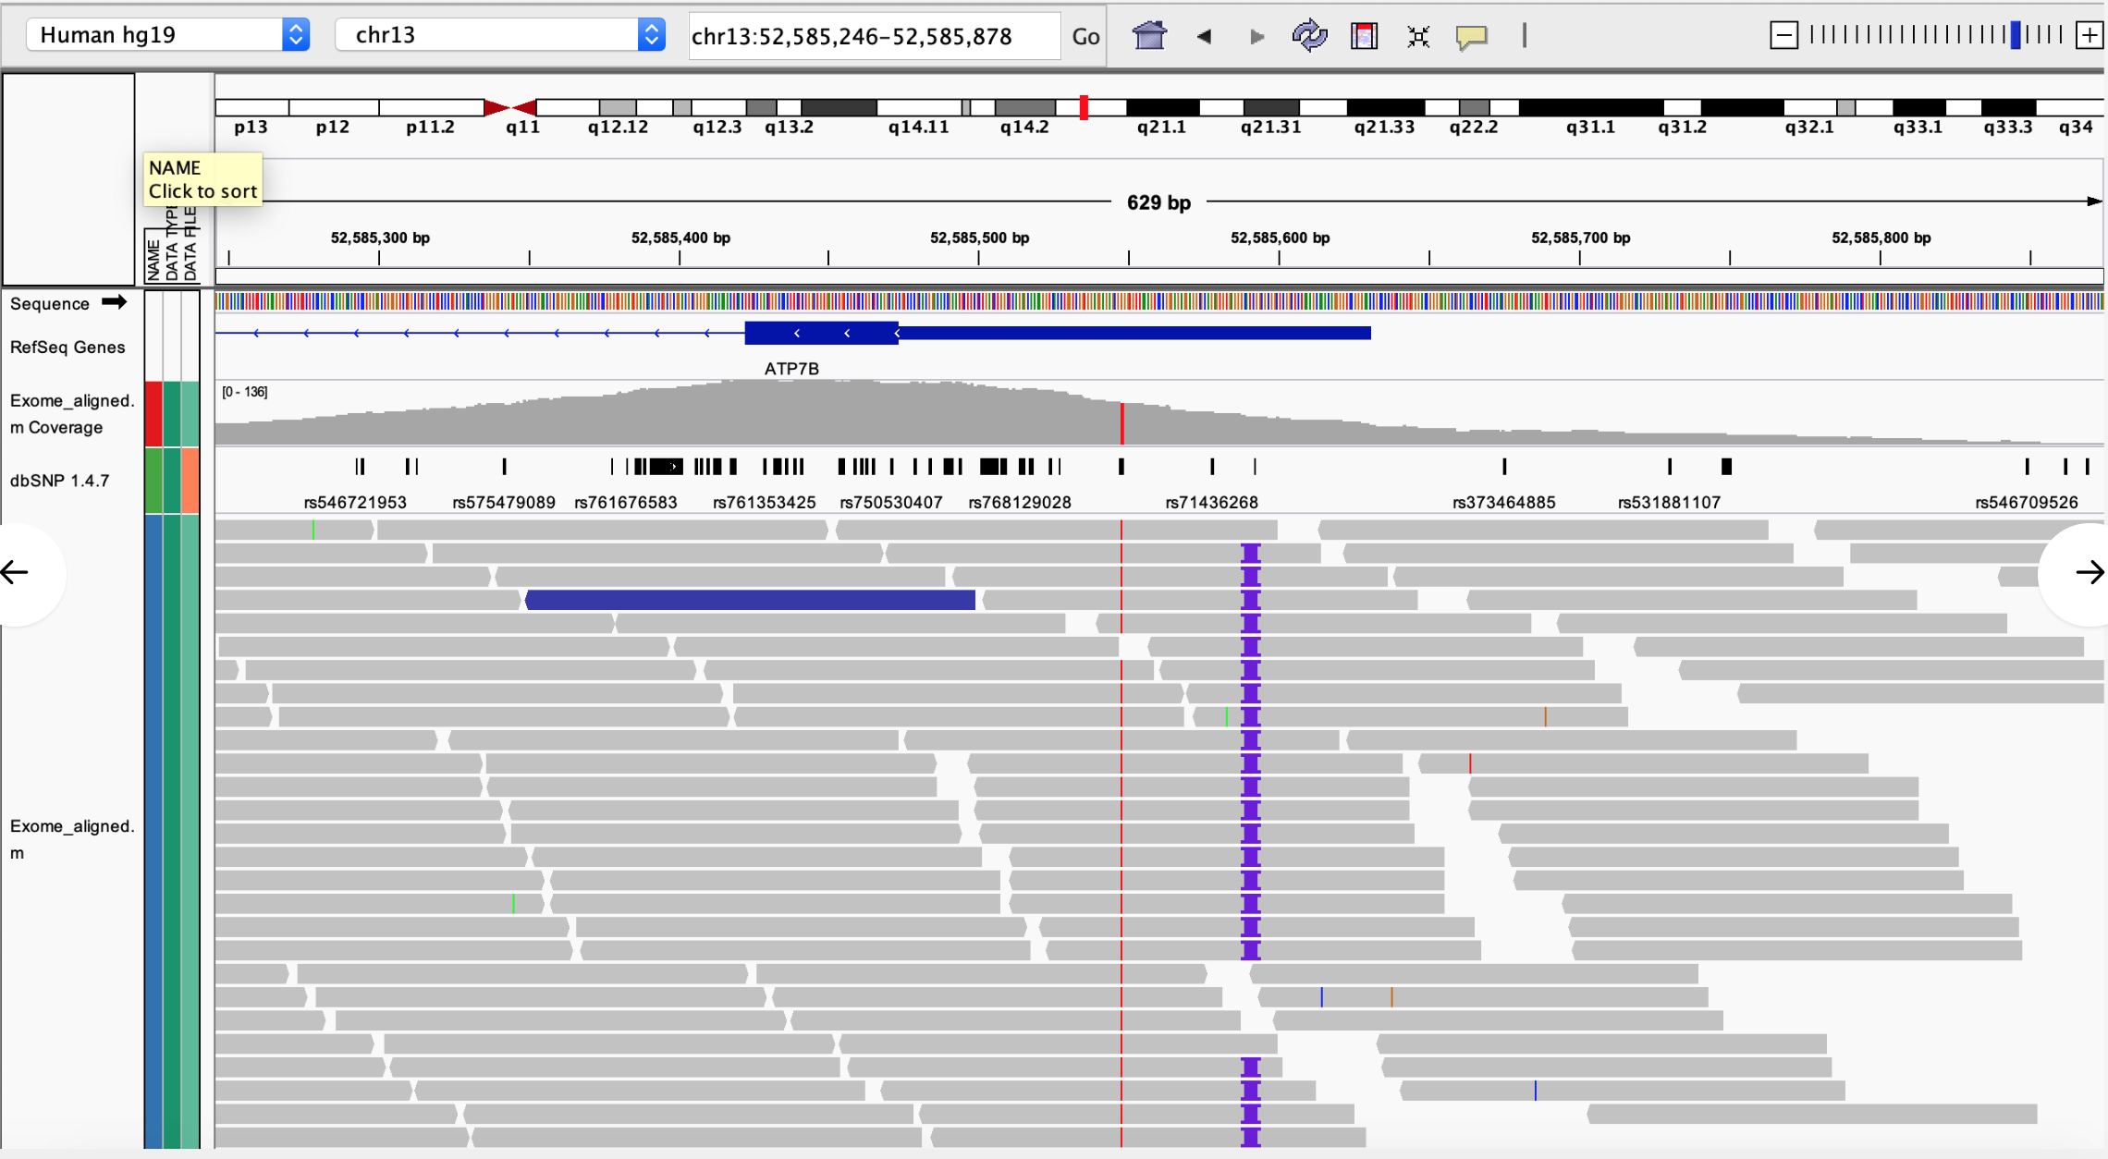
ATP7B/ALG11 is Homozygous

Slide 14
Secondary Recommendations 2
TTN: implicated in implicated in limb girdle muscular dystrophy, muscle weakness, growth failure
5 heterozygous variants:
1 affecting stop gain on translation
2 classified as possibly damaging (PolyPhen-2)
SCN5A: implicated in diabetic neuropathy, depression, acute pain, renal impairment, urinary issues, constipation, pelvic pain, vomiting, pharyngitis
3 heterogynous variants
WNK1: implicated in autonomic neuropathy, limb girdle muscular dystrophy, pelvic organ prolapse, kidney disease

Slide 15
Next Steps
Short-term
Mid-term
Long-term
Determine up- or down-regulation of RNA expression using existing small intestine biopsy tissue
Continue investigating secondary targets
Focus on high value target TNXB, and verify the loss-of-function by conventional methods with contract lab.
Complement gene variant analysis with incoming proteomics data
Combine tissue-specific protein data, as well as single-cell sequencing in gut and connective tissue
Work with academic labs to create an organoid model for ex vivo drug testing
15

Slide 16
Additional Slides
The remainder of this presentation is for understanding our process later.

Slide 17
References
Zweers, M. C., Bristow, J., Steijlen, P. M., Dean, W. B., Hamel, B. C., Otero, M., … Schalkwijk, J. (2003). Haploinsufficiency of TNXB is associated with hypermobility type of Ehlers-Danlos syndrome. American journal of human genetics, 73(1), 214–217. doi:10.1086/376564
Valcourt, U., Alcaraz, L. B., Exposito, J. Y., Lethias, C., & Bartholin, L. (). Tenascin-X: beyond the architectural function. Cell adhesion & migration, 9(1-2), 154–165. doi:10.4161/19336918.2014.994893
Botrus, G., Baker, O., Borrego, E., Ngamdu, K.S., Teleb, M., Gonzales Martinez, J.L., ... & McCallum, R. (2018). Spectrum of Gastrointestinal Manifestations in Joint Hypermobility Syndromes. The American journal of the medical sciences, 355(6), 573-80.
Nelson, A.D., Mouchli, M.A., Valentin, N., Deyle, D., Pichurin, P., Acosta, A., & Camilleri, M. (2015). Ehlers Danlos syndrome and gastrointestinal manifestations: a 20-year experience at Mayo Clinic. Neurogastroenterology and motility : the official journal of the European Gastrointestinal Motility Society, 27(11), 1657-66.
Aktar, R., Peiris, M., Fikree, A., Eaton, S., Kritas, S., Kentish, S.J., ... & Blackshaw, L.A. (2019). A novel role for the extracellular matrix glycoprotein-Tenascin-X in gastric function. The Journal of physiology, 597(6), 1503-15.
Parkman, H.P., Wilson, L.A., Hasler, W.L., McCallum, R.W., Sarosiek, I., Koch, K.L., ... & Pasricha, P.J.(in press). Abdominal Pain in Patients with Gastroparesis: Associations with Gastroparesis Symptoms, Etiology of Gastroparesis, Gastric Emptying, Somatization, and Quality of Life. Digestive diseases and sciences. doi:10.1007/s10620-019-05522-9
Demirdas, S., Dulfer, E., Robert, L., Kempers, M., van Beek, D., Micha, D., ... & Voermans, N.C. (2017). Recognizing the tenascin-X deficient type of Ehlers-Danlos syndrome: a cross-sectional study in 17 patients. Clinical genetics, 91(3), 411-25.
Axelrod, F.B. Genetic Autonomic Disorders. Semin Pediatr Neurol 20:3-11, 2013.

Slide 18
Ehlers Danlos III
EDS is a group of connective tissue disorders that affect the skin, bones, blood vessels, and many other organs and tissues.
Mutations that cause this form of the disorder occur in one copy of the TNXB gene in each cell. These mutations reduce the amount of functional tenascin-X that cells produce, which decreases the ability of tenascin-X to interact with collagens and elastic fibers. These changes weaken connective tissues in many parts of the body, which results in the signs and symptoms of the hypermobile type of Ehlers-Danlos syndrome.7
EDS III has been linked numerous times to GI dysmotility disorders, as well as other functional disorders like Gastric Reflux, Constipation, Nausea, Vomiting, Heartburn, abnormal gastric emptying, and abnormal colonic transit time 3,4.
18

Slide 19
TNXB and Tenascin-X contd.
In adults, TN-X mRNA is observed at varying levels in a number of organs and tissues with a higher level in the digestive tract (pancreas, stomach, jejunum, ileum, and colon).²
Previously, it has been shown that TNX is required for neural control of the bowel by a specific subtype of mainly cholinergic enteric neurons and regulates sprouting and sensitivity of nociceptive sensory endings in mouse colon.
These findings correlate with symptoms shown by TNX-deficient patients and mice⁵.
19

Slide 20
Tenascin-X, ECM, and the GI System
TNX was found to be present in calretinin-immunoreactive extrinsic nerve endings in mouse and human stomach.
TNX deficient mice had increased vagal afferent responses to gastric distension that could be rescued with GABA-B receptor agonist.
In TNXB-deficient patients, significantly greater symptoms of reflux, indigestion and abdominal pain were reported. A study published in only march of this year is the first to outline the role for TNX in gastric function.⁷
Further studies are required in TNX-deficient patients to classify groupings of symptoms and to determine whether symptoms can be relieved even partially using GABA-B agonists, like benzodiazepines, which the patient currently takes, and has found some relief using them.
20

